Slide 1
JIGA
Chemistry & Biology project

Slide 2
Table of contents
01
02
04
03
Our team
Our idea
Used Technologies
Stages of realizations

Slide 3
01
Our Team

Slide 4
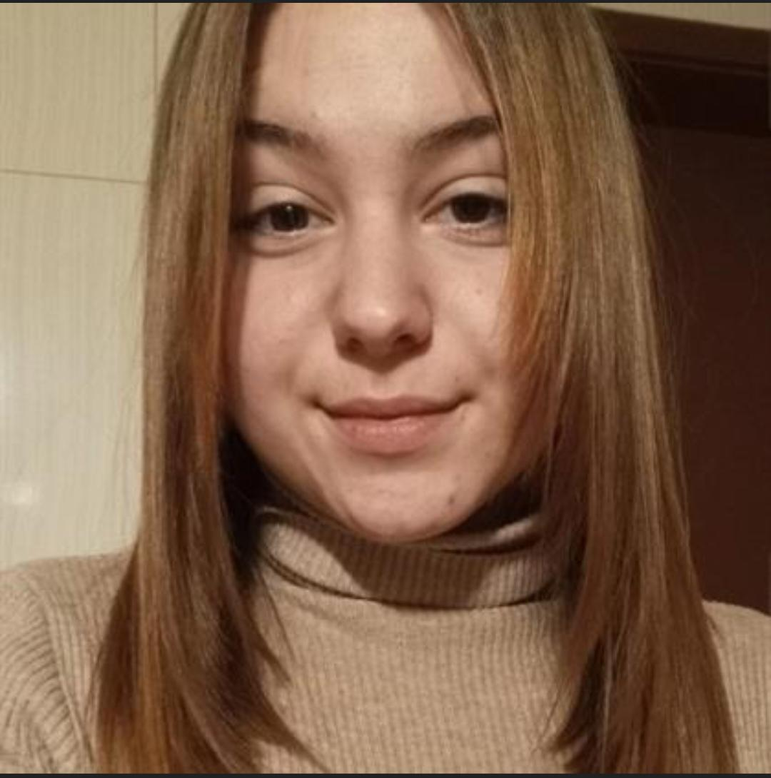
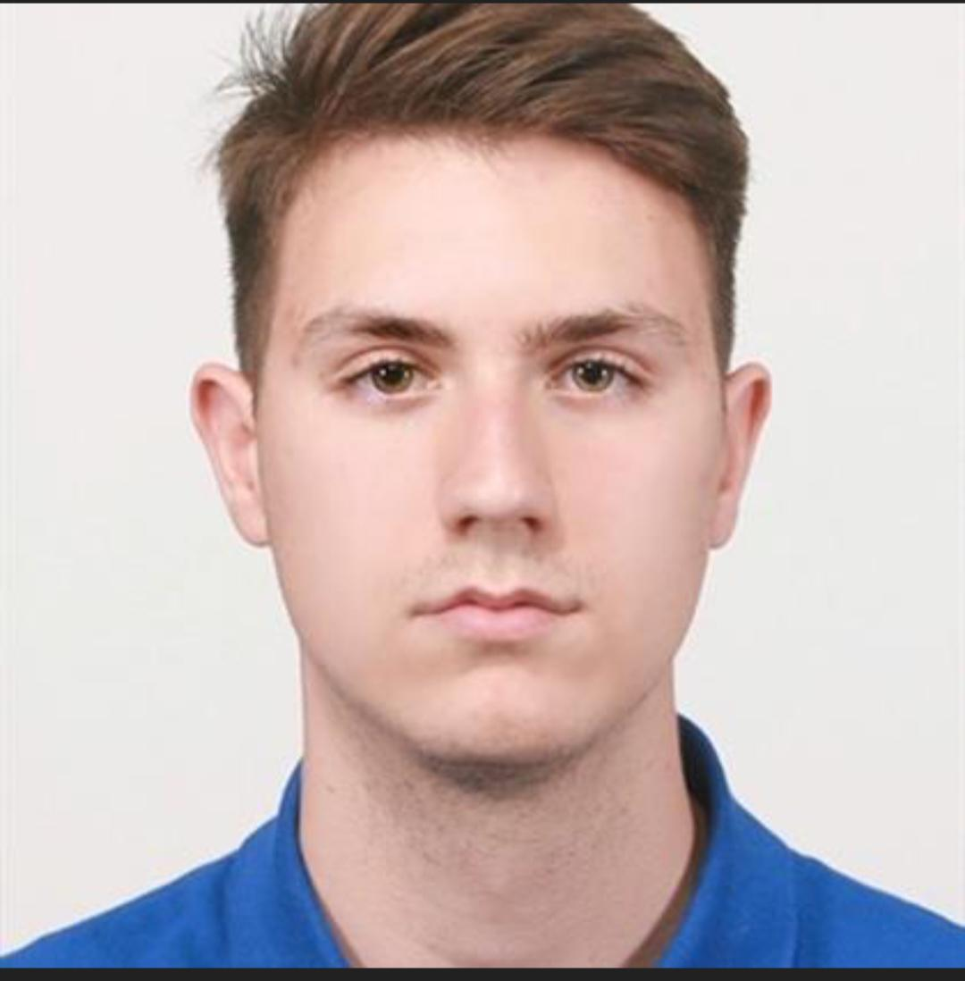
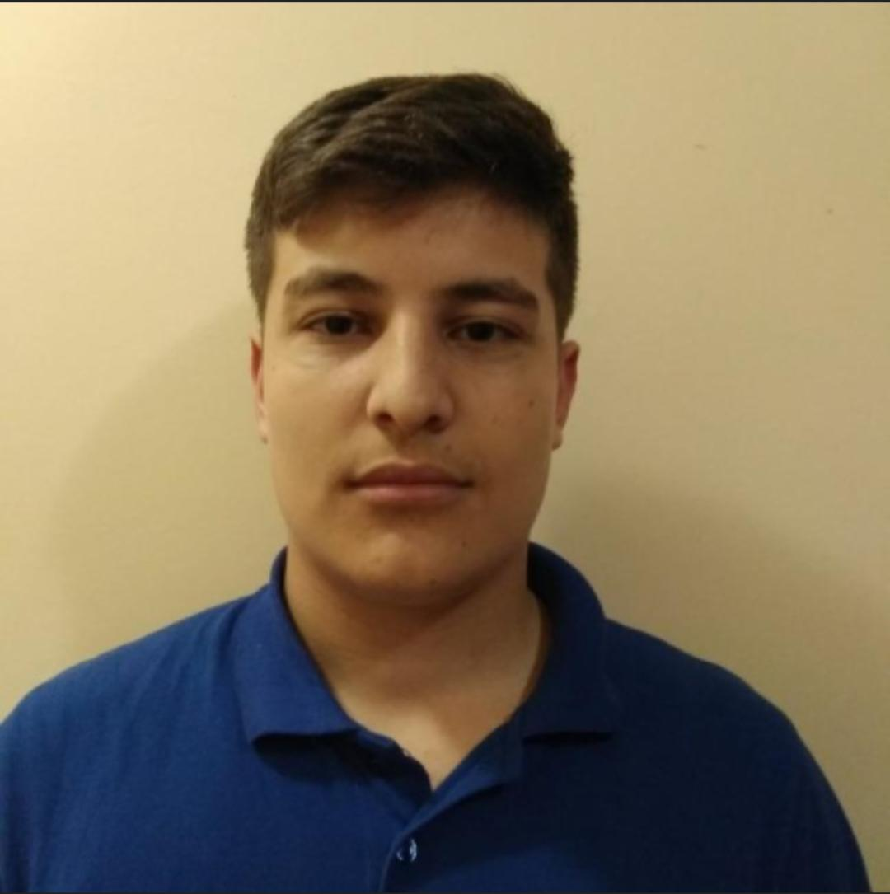
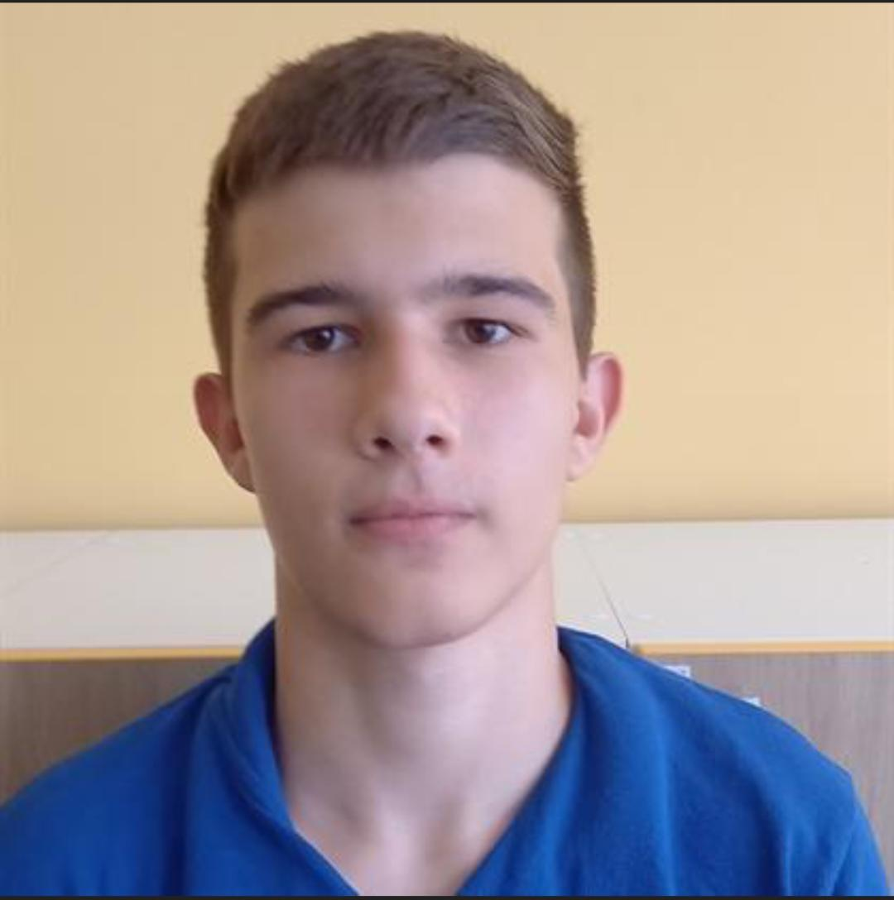
Jasmina Vulkova
Atanas Apostolov
QA developer
Scrum trainer
Ivailo Dandarinov
Georgi
Filipov
Backend developer
Backend developer

Slide 5
02
Our Idea

Slide 6
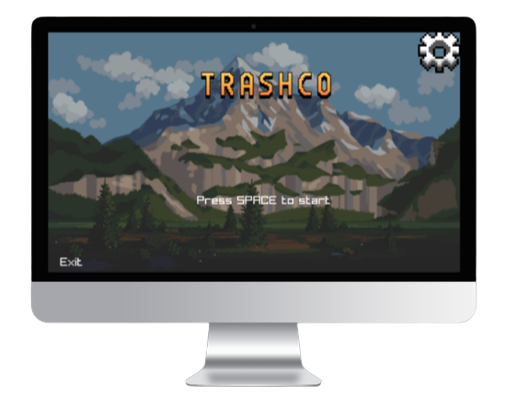
The idea of ​​the project is a game about ecology. On the screen, the user plays with a man who collects garbage on the screen.

Slide 7
03
Stages of realization

Slide 8
01
02
03
04
Realization
Test
Present
Idea & organization

Slide 9
04
Used languages

Slide 10









Slide 11
Let’s jump into the game!

